Slide 1

Interview Analysis using Face Detection
An AI-Powered System for Objective Candidate Evaluation
MCA Data Science Project
Presented by: Riya Kumari Bhagat
Guided by: Sreesh Bhat U | Lovely Professional University
Notes:
Welcome the panel. Introduce yourself and the title of the project: an AI-powered system that analyzes candidate expressions and engagement during video interviews using face detection. Mention this is your MCA final year project and briefly set expectations for the presentation flow.

Slide 2


Introduction
Interviews are essential for evaluating a candidate's technical knowledge, communication skills, and overall personality.
Traditional interview assessment relies on manual observation, which can be subjective and inconsistent.
Interview Analysis Using Face Detection leverages Artificial Intelligence and Computer Vision to objectively analyze a candidate's non-verbal behavior.
The system evaluates facial expressions, head pose, eye contact, and engagement from recorded interview videos.
An interactive Streamlit dashboard presents the analysis results through visual reports and performance metrics, helping recruiters make more informed decisions.
Why Face Detection?
Facial cues — expressions, gaze, and posture — carry rich information about a candidate’s confidence and engagement that structured questions alone cannot capture.
02 / 15
Notes:
Explain the motivation: interviews are subjective, and AI-based facial analysis can add an objective, data-driven layer to the process. Briefly describe what the system does at a high level before diving into the problem statement on the next slide.

Slide 3


Problem Statement
Subjective Evaluation
Limited Behavioral Analysis
Interview assessment depends on the interviewer's personal observation, which may lead to inconsistent and biased evaluations.
Traditional interviews focus mainly on verbal responses and often overlook important non-verbal cues such as facial expressions, eye contact, and head movements.
Manual Observation Challenges
Lack of Automated Reporting
It is difficult for interviewers to continuously monitor micro-expressions, attention level, and candidate engagement throughout the interview.
Most interview processes do not generate objective, measurable reports that summarize a candidate's behavioral performance.
03 / 15
Notes:
Walk through each problem: interviewer bias, absence of behavioural signals in traditional interviews, the limits of manual observation, and the lack of a structured, quantifiable report. This sets up why an automated face-detection based system is needed.

Slide 4


Project Objectives
Detect faces in real time from a webcam feed or a recorded interview video.
Recognize facial expressions and classify them into 7 standard emotion categories.
Estimate eye contact and attention using head pose and gaze direction.
Generate an objective report summarizing engagement and confidence for the interviewer.
Provide a simple web interface so non-technical interviewers can use the tool easily.
04 / 15
Notes:
List the five core objectives clearly: real-time face detection, emotion recognition, eye-contact and attention estimation, generating an objective report, and providing an easy-to-use interface. These map directly to the modules you will show later.

Slide 5







Technologies Used
Python
MediaPipe
OpenCV
Core programming language
Face landmarks & blendshapes
Video capture & image processing
Streamlit
NumPy
Pandas
Interactive web interface
Numerical computation
Data handling & reporting
05 / 15
Notes:
Introduce the technology stack: Python as the core language, MediaPipe for face landmark and expression detection, OpenCV for video handling, Streamlit for the web interface, and NumPy/Pandas for computation and reporting. Mention that the pipeline runs fully offline once set up.

Slide 6






System Architecture
Video Input
Face Detection
Feature Extraction
Analysis Engine
Report Generation
Webcam or uploaded interview video
MediaPipe FaceLandmarker locates the face
Landmarks, blendshapes & head pose
Emotion, eye contact & attention scoring
Aggregated engagement report
A modular pipeline: each stage feeds the next, from raw video to a structured interview report.
06 / 15
Notes:
Explain the end-to-end pipeline: video comes in from a webcam or file, MediaPipe detects the face, extracts landmarks and expression blendshapes, the analysis engine scores emotion/eye-contact/attention, and finally a report is generated. Emphasize that this is a modular design — each box is a separate, independently testable component in the codebase.

Slide 7




Basic Workflow
1. Start Session
2. Detect Face
3. Compute Metrics
4. Generate Report
Upload a video or start the live webcam
Locate the candidate’s face each frame
Emotion, eye contact, attention, visibility
Aggregate results into a final summary
07 / 15
Notes:
This is the simplified user-facing workflow: the interviewer starts a session (upload or live webcam), the system detects the face frame by frame, computes the key metrics continuously, and finally generates a report once the session ends.

Slide 8





Project Modules
Face Detector
Emotion Engine
Wraps MediaPipe to detect faces & landmarks per frame
Maps facial blendshapes to 7 emotion categories
Pose & Gaze Module
Aggregator
Computes head pose, eye contact & attention
Combines frame-level data into final scores
Video Source
Web Interface
Handles webcam / uploaded video streams
Streamlit UI for upload & live analysis
08 / 15
Notes:
The codebase is organized into six independent modules, mirroring the architecture diagram: a face detector, an emotion-scoring engine, a pose/gaze module for eye contact and attention, an aggregator that produces the final report, a video source handler, and the Streamlit web interface. This modular design made the project easier to test and extend.

Slide 9


Model & Prediction Process
Frame Capture
Landmark & Blendshape Extraction
Emotion Scoring
Pose & Gaze Scoring
One video frame is grabbed
MediaPipe FaceLandmarker returns 478 landmarks + 52 expression blendshapes
Rule-based mapping of blendshapes to 7 emotions
Head yaw/pitch → eye contact & attention flags
Per-frame result: dominant emotion, head yaw/pitch/roll, eye-contact flag, and attention flag — aggregated across all frames to produce the final report.
09 / 15
Notes:
Explain that MediaPipe’s FaceLandmarker model does the heavy lifting per frame — detecting the face, 478 3D landmarks and 52 expression blendshape scores, plus a head-pose transform. From there, a rule-based engine (inspired by the Facial Action Coding System) scores emotions, and head-pose thresholds determine eye contact and attention. This avoids needing a heavy separate deep-learning emotion model.

Slide 10

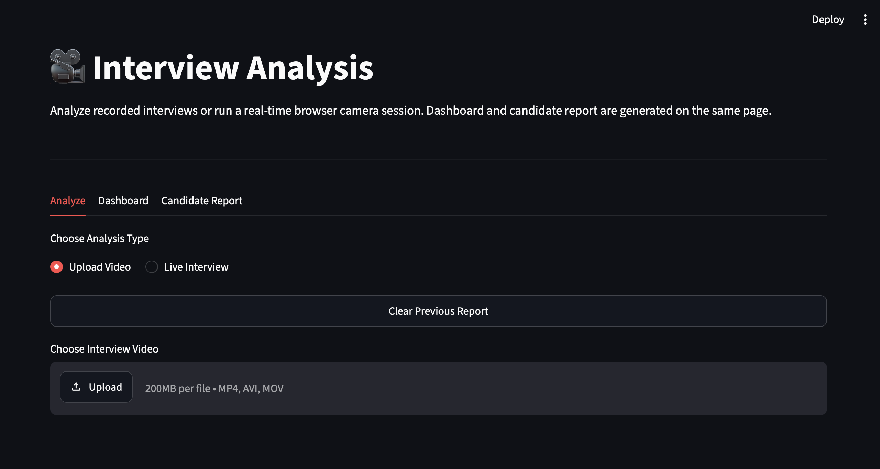
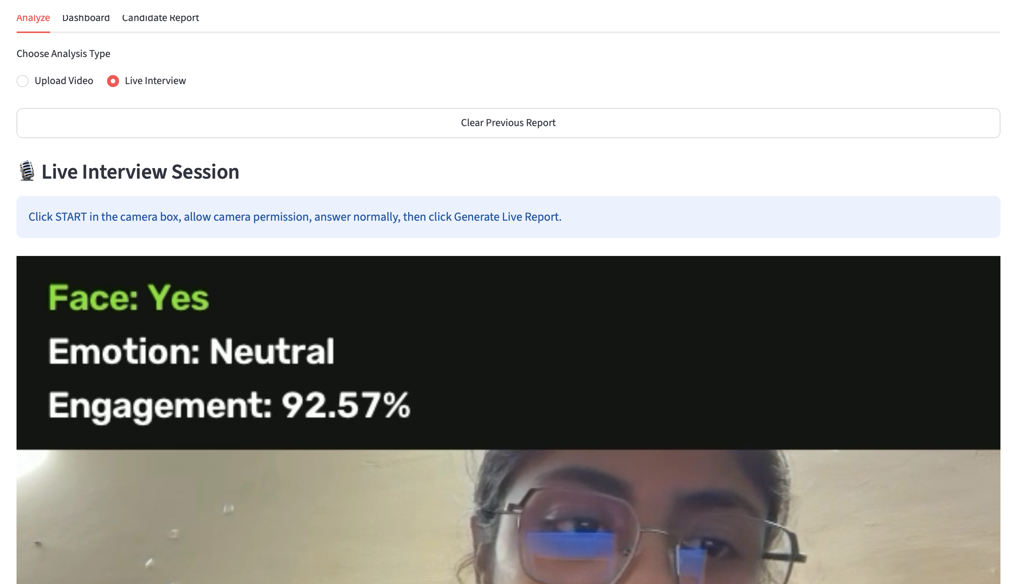

Streamlit User Interface
[ Screenshot: Upload Video Tab ]
[ Screenshot: Live Webcam Tab ]
Report with emotion chart & metrics
Real-time metrics while recording
Upload a recorded interview or run live webcam analysis
Live progress bar and running engagement metrics
Downloadable report in text and JSON format
10 / 15
Notes:
Show the two main tabs of the Streamlit app: Upload Video for pre-recorded interviews, and Live Webcam for real-time analysis. Insert actual screenshots of your running application into the two placeholder frames before presenting. Highlight the live progress bar, running metrics, and the downloadable report.

Slide 11

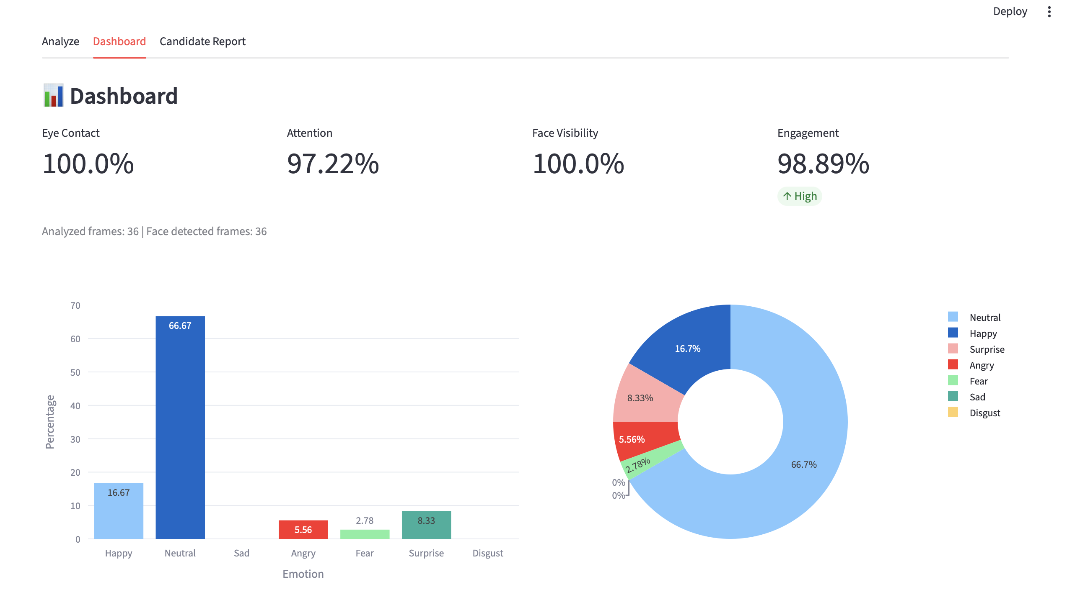
Results & Performance Analysis
[ Screenshot: Sample Candidate Report / Emotion Chart ]
Insert results from a test interview session
11 / 15
Notes:
Present sample results from a test run of the system — these example figures (87% eye contact, 91% attention, 96% face visibility, High engagement) should be replaced with your own test data. Insert a screenshot of an actual generated report or emotion chart in the placeholder below. Briefly discuss accuracy observations and any limitations you noted during testing.

Slide 12







Advantages
Objective Evaluation
Real-Time Feedback
Works Offline
Removes subjective interviewer bias from assessment
Live metrics available during the interview itself
Runs locally — no data leaves the interviewer’s machine
Easy to Use
Structured Reports
Saves Time
Simple web interface, no technical expertise required
Quantifiable, comparable results across candidates
Automated analysis reduces manual review effort
12 / 15
Notes:
Summarize the key benefits: objective evaluation free of bias, real-time feedback, offline/privacy-friendly operation, ease of use for non-technical interviewers, structured comparable reports, and time savings through automation.

Slide 13


Conclusion
The project successfully demonstrates real-time facial analysis for interview evaluation.
Face detection, emotion recognition, and attention tracking were integrated into one working pipeline.
The Streamlit interface makes the tool accessible to non-technical interviewers.
The system provides a useful, objective supplement to — not a replacement for — human judgment.
Project Outcome
A fully functional, modular, offline-capable interview analysis tool built with open-source computer vision technology — achieving all defined project objectives.
13 / 15
Notes:
Wrap up by restating that the project met its objectives: a working, modular face-detection based interview analysis pipeline with an accessible web interface. Emphasize it is meant to support, not replace, human interviewer judgment.

Slide 14





Future Scope
Deep Learning Emotion Model
Multi-Face Proctoring
Train a CNN classifier for higher emotion accuracy
Detect additional people in frame for exam integrity
Cloud Deployment
Mobile Application
Host the system for remote, scalable interview access
Extend analysis to Android/iOS interview apps
14 / 15
Notes:
Discuss potential extensions: replacing the rule-based emotion classifier with a trained deep-learning model for higher accuracy, adding multi-face detection for exam-style proctoring, deploying the system to the cloud for remote access, and building a companion mobile app.

Slide 15

Thank You
Questions & Discussion
Notes:
Thank the panel and invite questions. Be ready to discuss the emotion-scoring heuristics, MediaPipe’s blendshape output, the modular code structure, and the live-webcam implementation details, as these are the most likely areas for viva questions.

